Slide 1
Challenging White Supremacy Culture in Music Education:
A Collaborative
Workshop
By Nina Brian-Smith

Slide 2
Workshop Goals
Create an inclusive social justice community in this workshop and develop community-building strategies for your learning spaces.
Understand the ways in which white supremacy culture manifests in music education and society at large.
Develop an intersectional critical awareness of ourselves, our students, and our schools/communities.
Collect and create practical tools for dismantling white supremacy culture in our learning spaces.
Develop a plan for creating a more anti-racist and liberatory music education in short-term and long-terms ways.

Slide 3
Overview
LUNCH
White Supremacy Culture
Establish Community
Positionality
Critical Hip-Hop Pedagogy
Envisioning
Community Agreements,
Who is in the room?
Intro to Social Identities and Intersectionality,
Positionality Statements
Manifestations and Remedies in Music Education
Intro to Hip-Hop Pedagogy, Composition Workshop
How will we put our learning into action?

Slide 4
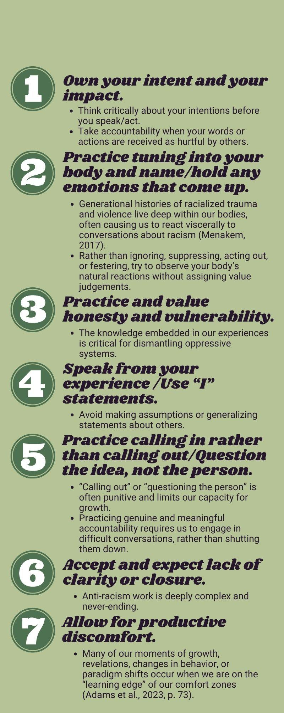
Community Agreements

Slide 5
Who is in the room?
Arrange yourselves in a large circle for an activity to find out!

Slide 6
Positionality

Slide 7
Social Identity
Social Identity Categories:
Definition:
Cis-man
Cis-woman
Trans man
Trans woman
Non-binary
Genderqueer
Gender fluid
Transmasculine
Transfeminine
AFAB
AMAB
The identities that we hold in different socially constructed categories.
These categories are “socially constructed” because they are not grounded in an objective, material reality, but were created and upheld in order to organize society.
Our social identities are tied to systems of power and oppression that have existed throughout history.
Race/Ethnicity
Gender*
Sexual orientation
Class
Dis/ability
Citizenship status
Religion
Age
Language
Education credentials
Body size

Slide 8
Intersectionality
Definition:
Our social identities are…
The idea that social identity categories such as race, gender, sexuality, class, dis/ability, religion, and age compound and reinforce each other through interlocking forms of oppression
Popularly coined by Crenshaw (1991) to articulate Black women’s experiences of both racism and misogyny
All other forms of oppression are upheld by and uphold white supremacy
Multiple
Intersectional
Chosen/Born
Fixed/Changing
Visible/Invisible
Influenced by context
The mix of our social identities gives us our social location/ positionality

Slide 9
My Positionality Statement
I am a white, U.S.-born, non-native, non-disabled, middle-class, queer, femme, young adult, college-educated scholar at a predominantly white institution. All of these identities inform my work and worldview. Professionally, I consider myself an academic and an activist who is primarily committed to the work of dismantling white supremacy in and out of music education. As a result of many of my identities, I experience unearned power and privilege that position me to do this work in a way that will often be viewed as neutral. Although I am committed to using my platforms to challenge white supremacy, my ability to participate in anti-racist work freely simultaneously reproduces the systems of oppression I seek to dismantle. This is a contradiction that is inherent and that I hold with importance throughout my work.

Slide 10
Write your own!
What social identities do you hold? Consider any/all of these categories: race/ethnicity, gender, sexual orientation, dis/ability, class, citizenship, religion, age, language, education credentials, size, etc.
Which of these social identities give you privilege? Which of these identities make you a target of oppression? How do you experience power and oppression as a result of all of your identities? How does this change on the basis of context?
Consider the population that you teach and the environment in which you teach. What are the social identities of your students? Which communities are you or your students situated in? What resources do you have access to?
What content do you teach most? How is that informed by your social identities?
Read statement
Share your process
State challenges
One potential use
Pair
Share:

Slide 11
II. White Supremacy Culture

Slide 12
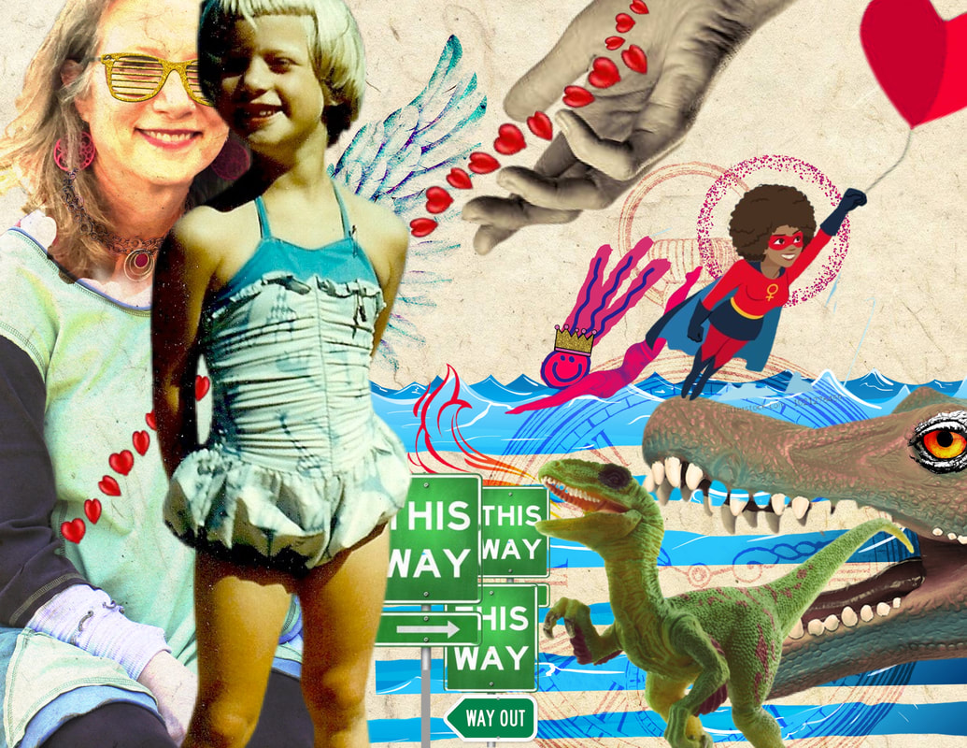
White Supremacy Culture Characteristics
Tema Okun
Whiteness is highly normalized/naturalized in our society
White supremacy limits all of us
Can identify how white supremacy operates implicitly and explicitly through these characteristics
Each characteristic is explained and antidotes are provided
Self-portrait of Tema Okun

Slide 13
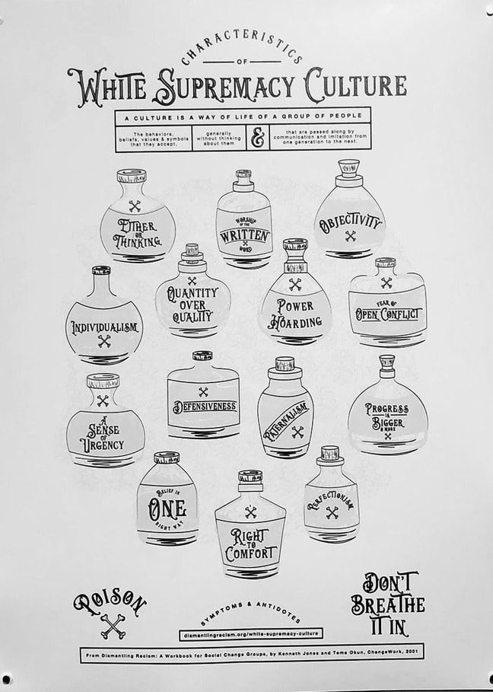
15 Characteristics:
Fear
One Right Way
Perfectionism
Paternalism
Objectivity
Either/Or and Binary Thinking
Denial and Defensiveness
Right to Comfort
Fear of Conflict
Power Hoarding
Individualism
Progress is More
Quantity Over Quality
Worship of the Written Word
Sense of Urgency

Slide 14
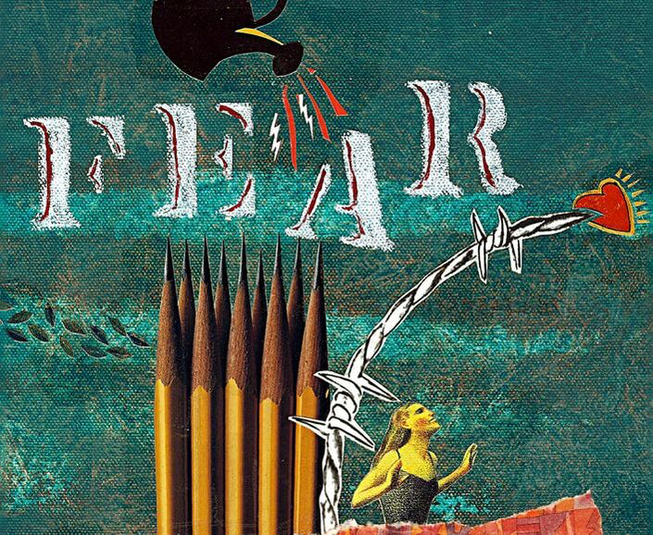
Example:
Fear
“White supremacy culture's number one strategy is to make us afraid. When we are afraid, we lose touch with our power and become more easily manipulated by the promise of an illusory safety”
Manifests as blame culture, shame, not belonging, repeating cycles of trauma/harm
Antidotes: embodied healing, processing trauma, cultivating community/belonging

Slide 15
01
Make Groups!

Slide 16
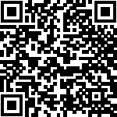
Groups + Assigned WSCC
01
02
03
04
05
One Right Way + Paternalism
Worship of the Written Word
Perfectionism
Individualism
Sense of Urgency
Notes:
Link to google doc: https://drive.google.com/drive/folders/1caFK_97zi8B6HCSXUKM8zzVFET0ovGBz?usp=share_link

Slide 17
02
Explore Your WSCC
How prevalent is this characteristic in popular culture?
How is it portrayed in the media?
Is it something that you would normally associate with whiteness or white supremacy?
What connotation does this characteristic typically get?
What do you associate with this characteristic?

Slide 18
03
Manifestations
Where did you see this WSCC in your K-12 music education?
Where did you see this in your pre-service training program?
How does this characteristic show up in your standards?
What behavioral management practices reinforce this characteristic?
How do your teaching practices perpetuate or challenge this WSCC? Try to be specific.

Slide 19
04
Remedies
What specific pedagogical tools have you used to challenge this characteristic?
What repertoire or content could be incorporated to help remedy this characteristic?
What needs to change in music education culture or school culture in order to accommodate remedies for this characteristic?
What do you wish you learned in your preservice program that would help you challenge this characteristic?
How could remedying this characteristic benefit your students and their communities?

Slide 20
Lunch Go-Around:
Share one word to describe your mood/energy level/vibe heading into lunch

Slide 21
III. Critical Hip-Hop Pedagogy

Slide 22
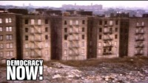
Foundations
Draws on Freire's concept of conscientization: the process by which students develop a critical consciousness
Critical literacy can be taught through lyrical analysis of hip-hop music
Hip-hop education goes beyond the musical genre; it includes using the forms of hip-hop (Ladson-Billings, 2015)
  Collage = Interdisciplinarity
  “Flipping something out of nothing” = Creative use of resources
  “Staying fresh” = Valuing youth culture
Hip-hop pedagogy centers counternarratives that destabilize dominant culture

Slide 23
How is it anti-racist?
The genre provides powerful examples of youth resistance to capitalism and white supremacy
Exemplifies the ways that music can be used for activism
Centering hip-hop means centering Black art and culture
Can be used to initiate conversations about race and racism
Potential Challenges or Missteps
Lack of familiarity:
  Address any personal bias you have against hip-hop
  Create opportunities to learn from your students
  Take accountability for gaps in your knowledge
  Lean into the forms of hip-hop rather than the vastness of the content
“Eating the Other” (hooks, 2015):
  Occurs when dominant groups consume the culture of marginalized groups purely for their own enjoyment or satisfaction
  It is critical that engagement with hip-hop is accompanied by explicit and intentional conversations about race and power

Slide 24
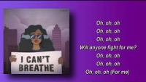
Critical Literacy Exercise
“I Can’t Breathe” by H.E.R.

Slide 25
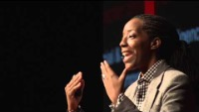
Dr. Bettina Love on Hip-Hop and Education

Slide 26
Composition Workshop!

Slide 27
IV. Action Planning

Slide 28
Reflection and Gallery Walk
Make a list of practical strategies for:
Attending to positionalities
Recognizing and remedying white supremacy culture
Developing a critical consciousness
Bringing hip-hop culture into the classroom

Slide 29
Make an Action Plan
What is one anti-racist practice you can incorporate into your classroom/learning space this week?
What 2-3 anti-racist elements can you incorporate into your curriculum for next semester?
One of the main ways that we create large-scale transformation is through our relationships with others. How will you share what you learned today? Can you talk to student parents? Colleagues? Community members? Administrators? Board members?
Hopefully, you feel inspired to create meaningful change after attending this workshop. How will you keep your passion alive? How will you hold yourself accountable? What reminders can you offer yourself when you’re feeling burntout?

Slide 30
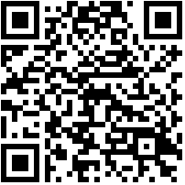
Thanks!
Feel free to reach out with questions or comments!
nbriansmith@umass.edu
Please complete a brief feedback survey:
Notes:
https://umassamherst.co1.qualtrics.com/jfe/form/SV_bIYtVLh1mn170Gy

Slide 31
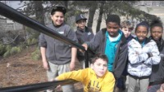
Conservatory Lab Charter School

